Slide 1
Serco data science use case: predicting the number of incidents occurs in each single day.
13 February 2023

Slide 2
decision to solve the problem:
Since we’re trying to predict something in the future using Machine learning, this problem will be considered as a time series forecasting problem, and to solve that kind of problem we’ll need to have enough data from the past that we can rely on to further be used with our mathematical and statistical technologies (ML models) to be able to make accurate and reliable predictions.

Slide 3
the features selected
After deciding which tables in the Immigration database we will be using, as not all the tables in it would give us the important feature or data that would help us develop our predictions, we selected Incident_Report, Incident_Detainees & Detainee_Profile tables between all the other tables in the database to be used in our processes, we’ve done some cleaning, wrangling, and pre-processing on their data to be suitable for the modelling process and found that all we needed from them is the processed number of incidents occurred in every single day and of course the Date column, as after performing a feature importance process on our model after fitting it with all the data, we found that it learns the best from the dayofweek column and some past or lagged versions of the target column that is the number of incidents occurred in each day.

Slide 4
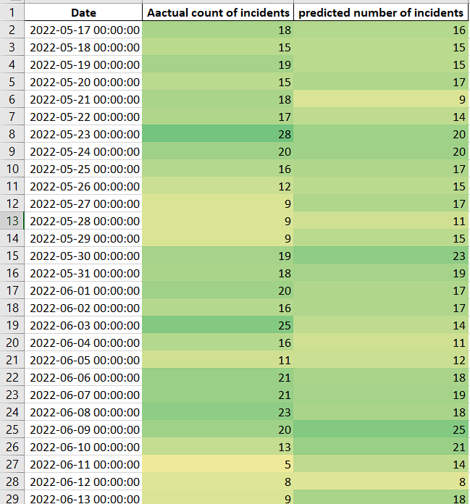
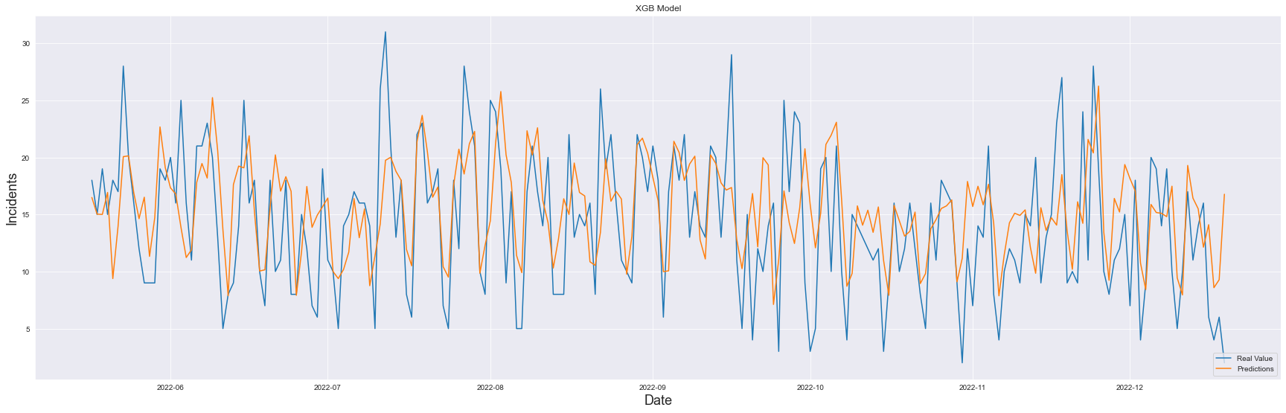
accuracy and analytics of findings against the scope
After doing our best to enhance our predicting model and evaluating its final predictions, we found that it has an accuracy of 20.7%, so it may seem to you it’s not that reliable accuracy but after we checked the graph that shows the predictions against the real data, we found that they are really close to each other, also after formatting a table that contains the predictions and the real data, we found that there’s a really correlated tone between the two columns.

Slide 5

roadmap:
PHASE 1
We started with getting familiar with the data, we read it and showed some samples of it and got some physical information about it.
PHASE 4
We created the XGBoost model.
Hyperparameter tuning.
Feature selection.
Evaluate the model.
Plotting the test data against the predictions.
PHASE 3
We separated the learning data from the target data.
Scaling the learning data.
Creating training samples and testing samples.
PHASE 2
We converted the Date column into usable format for further processing.
We grouped by date to get the number of incidents occurred in every single day.
We dropped off the outliers.
We Generated lagged target data.
We plotted the correlation between the overall dataset.
1
4
3
2
5
PHASE 5
We produced a .xlsx file that contains the final predictions.
Exporting the Final XGBoost model.

Slide 6
Next steps
Some potential options for next steps are presented here
Option | Description | Rough order of magnitude
Model refinement | Uplift work on each model to improve model performance and reduce errors. This might involve additional input data sets, further feature engineering, hypothesis testing and experiments, model retraining. | 1 – 2 sprints
Model generalization | Each model was developed against an example detention centre data set. Generalisation would retrain the models to make predictions against all of the centres and would store the data output so it is available for back testing for each centre | 1 sprint
Additional scenarios | Additional scenarios could be examined and tested for suitability for machine learning. This would involve gathering, conditioning and engineering data and building models to test hypotheses. | 2 - 3 sprints per scenario
Model production deployment | The existing models could be prepared for production deployment. This would involve ‘hardening’ of the model notebook Python code and integration with the Azure Data Factory and Data Lake infrastructure, together with development of supportive business facing production options such as model drift assessment, operations business engagement and production support recommendations | 1 – 2 sprints
UI and Dashboards for consumption | Dashboards hosted in PowerBI could be developed to surface model predictions and incorporate with actual operations data in a manner suitable for operations reporting. This would make use of graphs, heat maps and tabular data outputs for each model output A web based user interface as displayed in Appendix 2 would be developed which would provide a set of scenario analysis functions for the model, and which would allow them to be driven in real time. This would facilitate real-time usage of the model by Operations | 2 -3 sprints

